Slide 1
Great Moments in Ag Innovation
A Banner Series

Slide 2
Support Provided By:
Notes:
A grant was received from the DeKalb County Community Foundation Community Needs grant

Slide 3
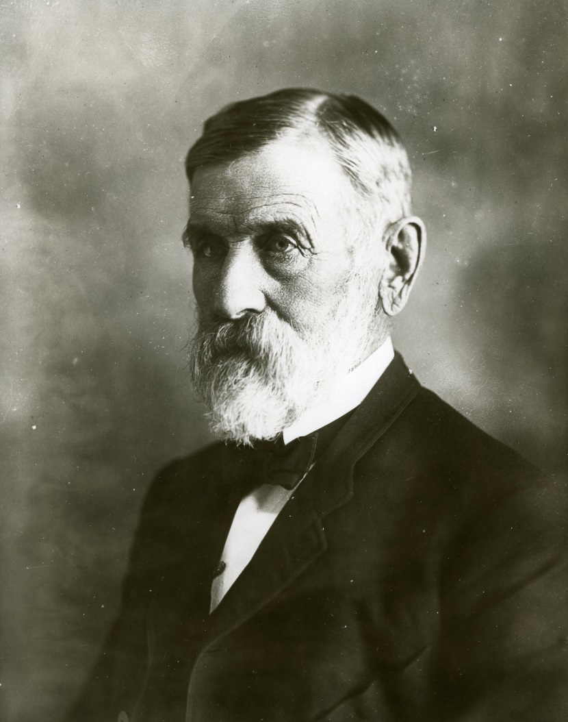
Marsh Harvester
Charles W Marsh
William W Marsh
Courtesy of the Joiner History Room
Notes:
The Marsh family settled in Illinois in 1849. The family spent their first day in DeKalb County “looking over our new country. It was ideal Indian summer weather. We were delighted with the prairie, with its breadth, its freshness and its freedom. We went up on "Holbrook's Knoll," a height a short distance southwest of the present village of Waterman, and from that elevated point surveyed the land. Southward an immense tract of treeless, undulating prairie, dotted by scattered cabins near the timber, was spread out before us, the view bounded by Shabbona Grove, Pritchard's Grove and Ross Grove to the right, by Indian Creek timber in front and by Somonauk timber to the left. Eastward was Squaw Grove and northward was the boundless prairie, the view in that direction unbroken by house or tree so far as the eye could reach.” (p. 36).
Charles W. Marsh. 1910. Recollections 1837 – 1910. Chicago: Farm Implement News Company.

Slide 4
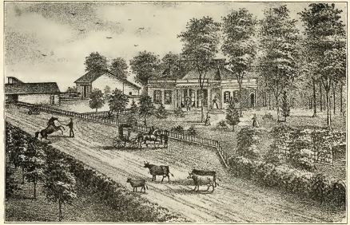
Recollections by Charles Marsh, 1910, page 71
Notes:
The old Marsh Home – where the first harvester was constructed
Prior to 1854 – Various farm implements and reapers in particular had been invented and were available. However, few DeKalb farmers purchased them as there was little incentive for large production farming.
In 1854 – a price boom increased awareness of the potentials of agriculture.
The 1850’s became a time of increased invention.
Farmers were able to increase their acreage and were receiving larger profits per acre providing the means to purchase machinery which were required to farm large tracts of land.
“Thus commenced the boom of the ‘fifties’; and thus was fully opened this wonderful era of production, development and world-wide adoption of American farm machinery.” “competition stimulated invention and improvement as never before”. (Recollections by Charles Marsh, p. 70)
This boom lasted until 1857.

Slide 5
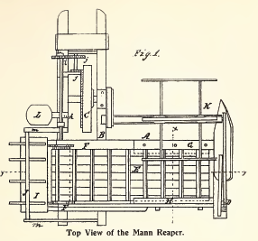
Notes:
Mann Reaper
Patented June 3, 1856 by Jacob and H. F. Mann of Westville, Indiana. (Patent number US15044)
The Marsh brothers purchased a Mann reaper with their neighbor to share resources. They bought out the neighbor’s share the very next year.
The Mann reaper provided inspiration for a grain binder. Although the brothers did not modify the Mann reaper, they did dismantle it and used the parts to build their first harvester. They experimented with binding grain and filed for a patent in 1858.

Slide 6
Notes:
First patent – improvement to reapers 1858 Patent no. 21207
How was grain harvested in the 1850’s?
Some farmers were still using
a grain cradle by hand
or a header machine
Most farmers were using a reaper which needed 4 – 6 men to bind
The harvester required only 2 men riding on the machine binding grain which cut labor and expenses in half.

Slide 7
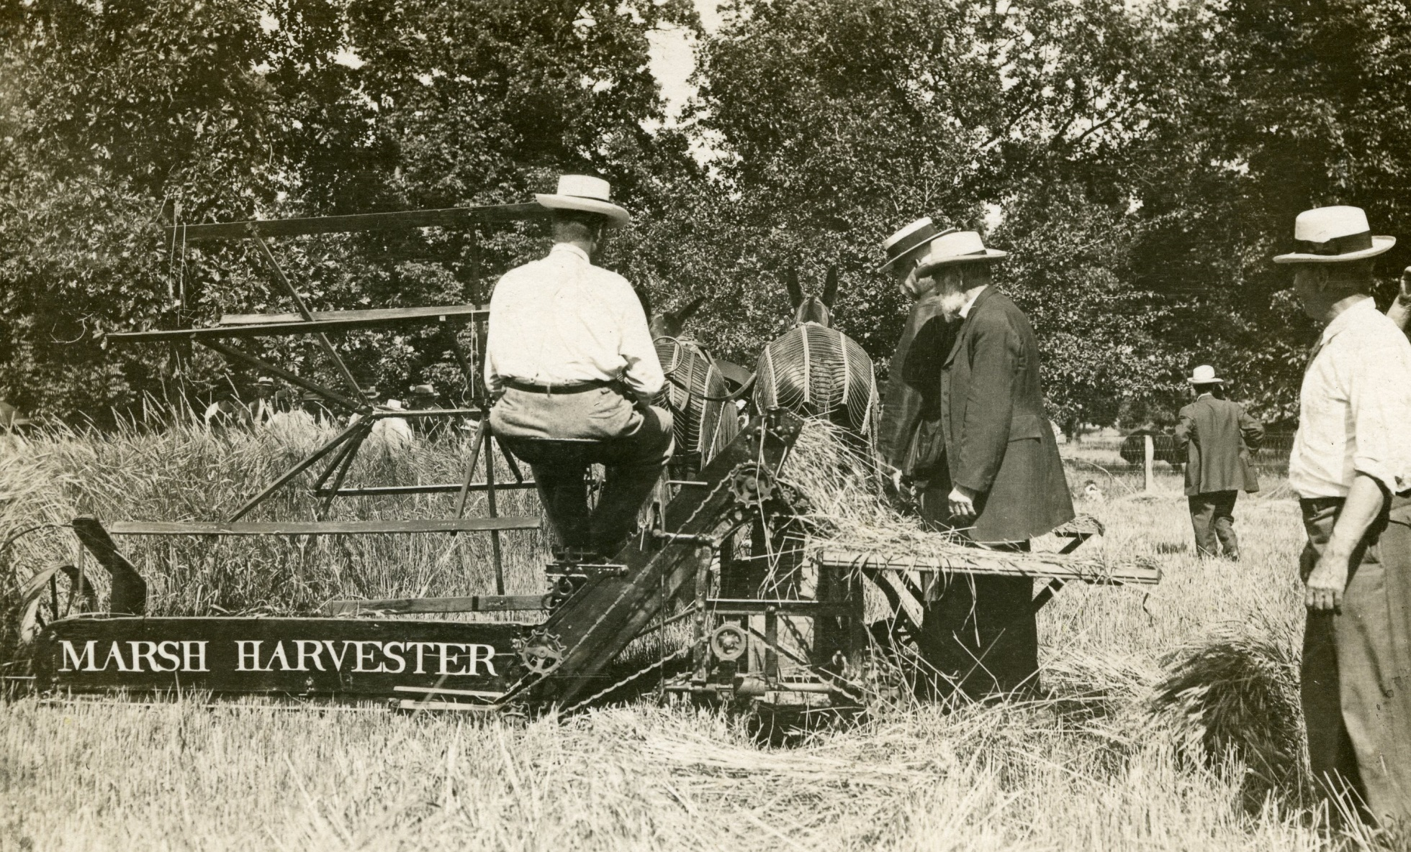
Courtesy of the Joiner History Room
Notes:
1859 – the Marsh brothers received orders from their neighbors for 12 machines for the 1860 harvest.
Foundation parts were made in Chicago, machine work was done in DeKalb and fittings were done at the Marsh home so the machines were “imperfectly constructed” (Recollections by Charles Marsh p. 87).
1860 – Poorly constructed machines combined with heavy growth in the 1860 season resulted in the machine failing and the orders were cancelled.
During the winter of 1860 – 61, the brothers worked on the machines and were able to have a successful machine for the 1861 harvest.
By 1863, they went to Plano for manufacturing and made 24 machines for the 1864 harvest. Within 2-3 years, the harvester was licensed to manufacturing companies in Rockford, Il and Springfield, OH.
At this time, this was the only harvester on the market and the Marsh brothers had to overcome customer prejudices and negative publications from reaper manufacturers who condemned this new innovation.

Slide 8
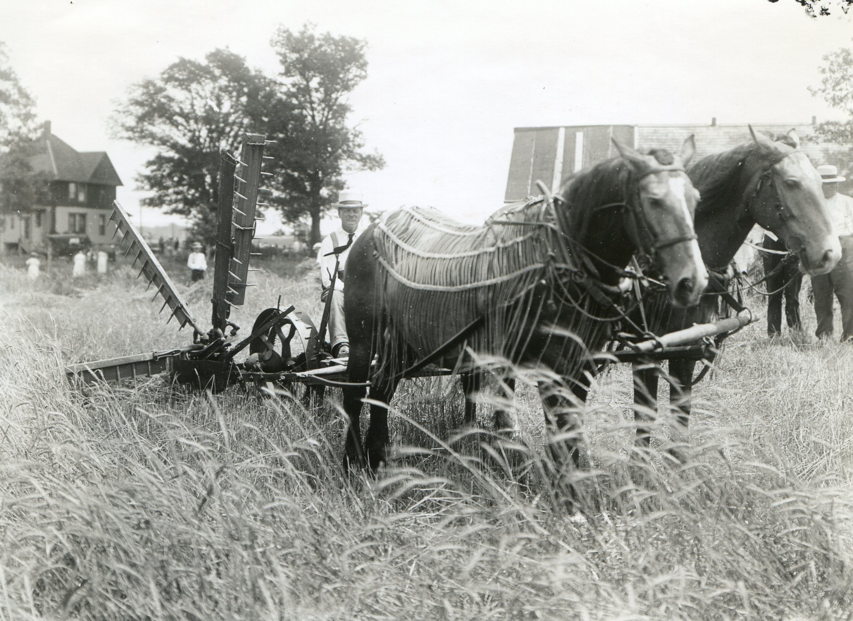
Notes:
The Civil War here at home as well as “foreign demand greatly stimulated production with the result that the area under cultivation was rapidly increases; and so was the demand for improved farm machinery, not only in consequence of the larger acreage but because scarcity of help required more and better implements.” (Recollections by Charles Marsh, p. 131)
Civil War and Foreign demand stimulated machine production resulting in greater areas under cultivation.
Machines were needed for the larger acreage and the scarcity of farm laborers.

Slide 9
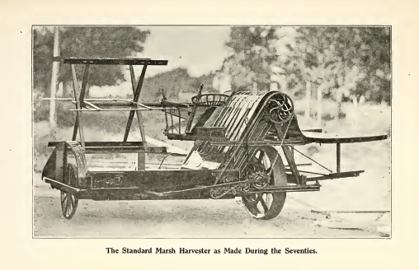
Recollections by Charles Marsh, 1910, page 85
Notes:
The Marsh Harvester was alone on the market until 1875.
p. 89 “Alone the Marsh harvester changed the system from “reaping” to “harvesting”. And alone it prepared the way and furnished the only foundation for the next and last great advance in harvesting, the successful introduction of the automatic binder … “ (Recollections by Charles Marsh)
“Although the Marsh harvester was a machine that accomplished more in reducing the labor and expense of harvest than any of the reapers, its invention or production was a simple process. There were no difficult mechanical problems to solve as in the production of a binder. The only remarkable fact to note is this, that we so combined and used the elements and limited means at our disposal as to obtain in the first machine the results we sought. Knowing little or nothing of mechanics, but being well posted in practical harvesting as it was then conducted, we took the most direct road to the end desired.”

Slide 10
Sources:
Joiner History Room, Sycamore, IL
Recollections 1837 – 1910, 1910, Charles W. Marsh, Chicago: Farm Implement News Company.

